Slide 1
Prototype By Kevin Gonzalez, Isai Gonzalez, Oscar Galido, Julio De La Cruz, and Alan Caldelas.

Slide 2

Network Traffic Proxy
File
View
Help
Start
Enter Filter(s) (Separated by commas)
…
Save all
No.
Source
Destination
Protocol
Hooks
Proxy Settings
Packet info
Edit
Drop
Forward
View:
Dissected
Hex
Binary

Slide 3
Network Traffic Proxy
File
View
Help
Stop
Enter Filter(s) (Separated by commas)
…
Save all
No.
Source
Destination
Protocol
1
Source-name
Destination-name
TCP
Hooks
2
Source-name
Destination-name
TCP
Proxy Settings
3
Source-name
Destination-name
TCP
4
Source-name
Destination-name
TCP
5
Source-name
Destination-name
TCP
6
Source-name
Destination-name
TCP
7
Source-name
Destination-name
TCP
8
Source-name
Destination-name
TCP
9
Source-name
Destination-name
TCP
10
Source-name
Destination-name
TCP
Packet info
Edit
Drop
Forward
View:
Dissected
Hex
Binary

Slide 4

Network Traffic Proxy
File
View
Help
Stop
Enter Filter(s) (Separated by commas)
…
Save all
No.
Source
Destination
Protocol
1
Source-name
Destination-name
TCP
Hooks
2
Source-name
Destination-name
TCP
Proxy Settings
3
Source-name
Destination-name
TCP
4
Source-name
Destination-name
TCP
5
Source-name
Destination-name
TCP
6
Source-name
Destination-name
TCP
7
Source-name
Destination-name
TCP
8
Source-name
Destination-name
TCP
9
Source-name
Destination-name
TCP
10
Source-name
Destination-name
TCP
Packet info
Edit
Drop
Forward
View:
Dissected
Hex
Binary

Slide 5
Network Traffic Proxy
Home Directory
Name
Date modified
Type
Size
Sample_PCAP_1
10/21/2018
PCAP
10 MB
Sample_PCAP_2
10/21/2018
PCAP
52 MB
Sample_PCAP_3
10/21/2018
PCAP
26 MB
File name
Save as Type
▼
PCAP
Save
Cancel

Slide 6
Network Traffic Proxy
File
View
Help
Stop
Enter Filter(s) (Separated by commas)
…
Save all
No.
Source
Destination
Protocol
1
Source-name
Destination-name
TCP
Hooks
2
Source-name
Destination-name
TCP
Proxy Settings
3
Source-name
Destination-name
TCP
4
Source-name
Destination-name
TCP
5
Source-name
Destination-name
TCP
6
Source-name
Destination-name
TCP
7
Source-name
Destination-name
TCP
8
Source-name
Destination-name
TCP
9
Source-name
Destination-name
TCP
10
Source-name
Destination-name
TCP
Packet info
Edit
Drop
Forward
View:
Dissected
Hex
Binary

Slide 7
Network Traffic Proxy
File
View
Help
Stop
Enter Filter(s) (Separated by commas)
…
Save all
No.
Source
Destination
Protocol
1
Source-name
Destination-name
TCP
Hooks
2
Source-name
Destination-name
TCP
Proxy Settings
3
Source-name
Destination-name
TCP
4
Source-name
Destination-name
TCP
5
Source-name
Destination-name
TCP
6
Source-name
Destination-name
TCP
7
Source-name
Destination-name
TCP
8
Source-name
Destination-name
TCP
9
Source-name
Destination-name
TCP
10
Source-name
Destination-name
TCP
11
Source-name
Destination-name
TCP
12
Source-name
Destination-name
TCP
Packet info
Edit
Drop
Forward
View:
Dissected
Hex
Binary

Slide 8
Network Traffic Proxy > Advanced Filter
File
View
Help
Protocol
Relation:
Port
(Options for equal)
TCP
1
20/21
Range:
(offset)
TCP/UDP
22
Ports:
TCP
(0-1023)
TCP
23
25
Fields
TCP
53
Destination
TCP/UDP
67/68
Protocol
UDP
137/138/139
Source
TCP/UDP
143
TCP
TCP
179
Comments
TCP
443
TCP
989/990
Save
Cancel

Slide 9
Network Traffic Proxy > Advanced Filter
File
View
Help
Protocol
Relation:
Port
(Options for equal)
TCP
1
20/21
Range:
(offset)
TCP/UDP
22
Ports:
TCP
(0-1023)
TCP
23
25
Fields
TCP
53
Destination
TCP/UDP
67/68
Protocol
UDP
137/138/139
Source
TCP/UDP
143
TCP
TCP
179
Comments
TCP
443
TCP
989/990
Save
Cancel

Slide 10
Network Traffic Proxy > Advanced Filter
File
View
Help
Protocol
Relation:
Port
(Options for equal)
TCP
1
20/21
Range:
(offset)
TCP/UDP
22
Ports:
TCP
(0-1023)
TCP
23
25
Fields
TCP
53
Destination
TCP/UDP
67/68
Protocol
UDP
137/138/139
Source
TCP/UDP
143
TCP
TCP
179
Comments
TCP
443
TCP
989/990
Save
Cancel

Slide 11
Network Traffic Proxy > Advanced Filter
File
View
Help
Protocol
Relation:
Port
==
TCP
1
20/21
Range:
(offset)
TCP/UDP
22
Ports:
TCP
(0-1023)
TCP
23
25
Fields
TCP
53
Destination
TCP/UDP
67/68
Protocol
UDP
137/138/139
Source
TCP/UDP
143
TCP
TCP
179
Comments
TCP
443
TCP
989/990
Save
Cancel

Slide 12
Network Traffic Proxy > Advanced Filter
File
View
Help
Protocol
Relation:
Port
==
TCP
1
20/21
Range:
(offset)
TCP/UDP
22
Ports:
TCP
(0-1023)
TCP
23
25
Fields
TCP
53
Destination
TCP/UDP
67/68
Protocol
UDP
137/138/139
Source
TCP/UDP
143
TCP
TCP
179
Comments
TCP
443
TCP
989/990
Save
Cancel

Slide 13
Network Traffic Proxy
File
View
Help
Stop
Enter Filter(s) (Separated by commas)
…
Save all
No.
Source
Destination
Protocol
1
Source-name
Destination-name
TCP
Hooks
2
Source-name
Destination-name
TCP
Proxy Settings
3
Source-name
Destination-name
TCP
4
Source-name
Destination-name
TCP
5
Source-name
Destination-name
TCP
6
Source-name
Destination-name
TCP
7
Source-name
Destination-name
TCP
8
Source-name
Destination-name
TCP
9
Source-name
Destination-name
TCP
10
Source-name
Destination-name
TCP
11
Source-name
Destination-name
TCP
12
Source-name
Destination-name
TCP
Packet info
Edit
Drop
Forward
View:
Dissected
Hex
Binary

Slide 14
Network Traffic Proxy
File
View
Help
Stop
Enter Filter(s) (Separated by commas)
…
Save all
No.
Source
Destination
Protocol
1
Source-name
Destination-name
TCP
Hooks
2
Source-name
Destination-name
TCP
Proxy Settings
3
Source-name
Destination-name
TCP
4
Source-name
Destination-name
TCP
5
Source-name
Destination-name
TCP
6
Source-name
Destination-name
TCP
7
Source-name
Destination-name
TCP
8
Source-name
Destination-name
TCP
9
Source-name
Destination-name
TCP
10
Source-name
Destination-name
TCP
11
Source-name
Destination-name
TCP
12
Source-name
Destination-name
TCP
Packet info
Edit
Drop
Forward
View:
Dissected
Hex
Binary

Slide 15
Network Traffic Proxy
File
View
Help
Stop
Enter Filter(s) (Separated by commas)
…
Save all
No.
Source
Destination
Protocol
1
Source-name
Destination-name
TCP
Hooks
2
Source-name
Destination-name
TCP
Proxy Settings
3
Source-name
Destination-name
TCP
4
Source-name
Destination-name
TCP
5
Source-name
Destination-name
TCP
6
Source-name
Destination-name
TCP
7
Source-name
Destination-name
TCP
8
Source-name
Destination-name
TCP
9
Source-name
Destination-name
TCP
10
Source-name
Destination-name
TCP
11
Source-name
Destination-name
TCP
12
Source-name
Destination-name
TCP
Packet info
Edit
Drop
Forward
View:
Dissected
Hex
Binary

Slide 16
Network Traffic Proxy
File
View
Help
Stop
Enter Filter(s) (Separated by commas)
…
Save all
No.
Source
Destination
Protocol
1
Source-name
Destination-name
TCP
Hooks
2
Source-name
Destination-name
TCP
Proxy Settings
3
Source-name
Destination-name
TCP
4
Source-name
Destination-name
TCP
5
Source-name
Destination-name
TCP
6
Source-name
Destination-name
TCP
7
Source-name
Destination-name
TCP
8
Source-name
Destination-name
TCP
9
Source-name
Destination-name
TCP
10
Source-name
Destination-name
TCP
11
Source-name
Destination-name
TCP
12
Source-name
Destination-name
TCP
Packet info
Edit
Drop
Forward
View:
Dissected
Hex
Binary
Frame 7:…
Ethernet II,…
Internet Protocol Version 4,…
Transmission Control Protocol,…

Slide 17
Network Traffic Proxy
File
View
Help
Stop
Enter Filter(s) (Separated by commas)
…
Save all
No.
Source
Destination
Protocol
1
Source-name
Destination-name
TCP
Hooks
2
Source-name
Destination-name
TCP
Proxy Settings
3
Source-name
Destination-name
TCP
4
Source-name
Destination-name
TCP
5
Source-name
Destination-name
TCP
6
Source-name
Destination-name
TCP
7
Source-name
Destination-name
TCP
8
Source-name
Destination-name
TCP
9
Source-name
Destination-name
TCP
10
Source-name
Destination-name
TCP
11
Source-name
Destination-name
TCP
12
Source-name
Destination-name
TCP
Packet info
Edit
Drop
Forward
View:
Dissected
Hex
Binary
Frame 7:…
Encapsulation type:…
Arrival Time:…
…
Ethernet II,…
Internet Protocol Version 4,…
Transmission Control Protocol,…

Slide 18
Network Traffic Proxy
File
View
Help
Stop
Enter Filter(s) (Separated by commas)
…
Save all
No.
Source
Destination
Protocol
1
Source-name
Destination-name
TCP
Hooks
2
Source-name
Destination-name
TCP
Proxy Settings
3
Source-name
Destination-name
TCP
4
Source-name
Destination-name
TCP
5
Source-name
Destination-name
TCP
6
Source-name
Destination-name
TCP
8
Source-name
Destination-name
TCP
9
Source-name
Destination-name
TCP
10
Source-name
Destination-name
TCP
11
Source-name
Destination-name
TCP
12
Source-name
Destination-name
TCP
Packet info
Edit
Drop
Forward
View:
Dissected
Hex
Binary

Slide 19
Network Traffic Proxy – Edit Packet
File
View
Help
Save
Save changes
Frame 7
Encapsulation type:…
Arrival Time:…
…
Ethernet II
Destination:…
…
Source:…
…
Type:…
…
Internet Protocol Version 4
… = Version:…
…
Differentiated Services Field:…
…
Total Length:…
…
Transmission Control Protocol
Fuzz…
Cancel
Forward
Drop
Close

Slide 20
Network Traffic Proxy – Edit Packet
File
View
Help
Save
Save changes
Frame 7
Encapsulation type:…
Arrival Time:…
…
Network Traffic Proxy
Ethernet II
Destination:…
…
Source:…
…
Type:…
…
All unsaved changes will be lost.
Continue?
Yes
No
Internet Protocol Version 4
… = Version:…
…
Differentiated Services Field:…
…
Total Length:…
…
Transmission Control Protocol
Fuzz…
Cancel
Forward
Drop
Close

Slide 21
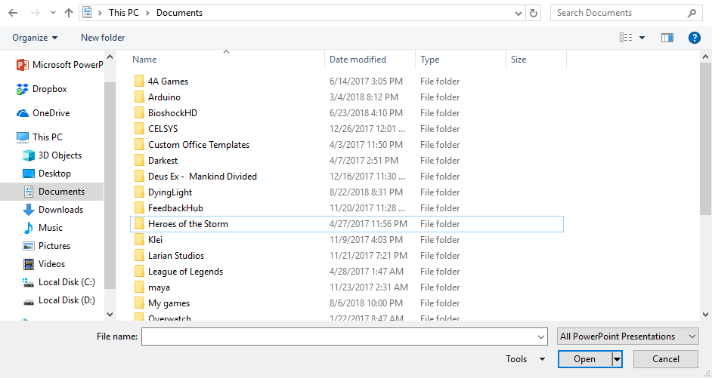
Network Traffic Proxy – Fuzzer
File
View
Help
Save
Select files to use as samples for AFL:
Example1 10/21/2018 PCAP 200 KB
Example2 10/21/2018 PCAP 250 KB
.pcap
Open
Selected files:
Select fields you want to fuzz:
Ethernet II
Destination
Source
Type
Internet Protocol Version 4
…
…
…
…
..
Cancel
Continue

Slide 22
Network Traffic Proxy – Fuzzer
File
View
Help
Save
Select files to use as samples for AFL:
Example1 10/21/2018 PCAP 200 KB
Example2 10/21/2018 PCAP 250 KB
.pcap
Open
Selected files:
Select fields you want to fuzz:
Ethernet II
Destination
Source
Type
Internet Protocol Version 4
…
…
…
…
..
Cancel
Continue

Slide 23
Network Traffic Proxy – Fuzzer
File
View
Help
Save
Select files to use as samples for AFL:
Example1 10/21/2018 PCAP 200 KB
Example2 10/21/2018 PCAP 250 KB
.pcap
Open
Selected files:
Example1.pcap
Remove
Select fields you want to fuzz:
Ethernet II
Destination
Source
Type
Internet Protocol Version 4
…
…
…
…
..
Cancel
Continue

Slide 24
Network Traffic Proxy – Fuzzer
File
View
Help
Save
Select files to use as samples for AFL:
Example1 10/21/2018 PCAP 200 KB
Example2 10/21/2018 PCAP 250 KB
.pcap
Open
Selected files:
Example1.pcap
Remove
Select fields you want to fuzz:
Ethernet II
Destination
Source
Type
Internet Protocol Version 4
…
…
…
…
..
Cancel
Continue

Slide 25
Network Traffic Proxy – Fuzzer
File
View
Help
Save
Select files to use as samples for AFL:
Example1 10/21/2018 PCAP 200 KB
Example2 10/21/2018 PCAP 250 KB
.pcap
Open
Selected files:
Example1.pcap
Remove
Select fields you want to fuzz:
Ethernet II
Destination
Source
Type
Internet Protocol Version 4
…
…
…
…
..
Cancel
Continue

Slide 26
Network Traffic Proxy – Fuzzer
File
View
Help
Save
Select files to use as samples for AFL:
Example1 10/21/2018 PCAP 200 KB
Example2 10/21/2018 PCAP 250 KB
.pcap
Open
Selected files:
Example1.pcap
Remove
Select fields you want to fuzz:
Ethernet II
Destination
Source
Type
Internet Protocol Version 4
…
…
…
…
..
Cancel
Continue

Slide 27
Network Traffic Proxy – Fuzzer
File
View
Help
Save
Select files to use as samples for AFL:
Example1 10/21/2018 PCAP 200 KB
Example2 10/21/2018 PCAP 250 KB
.pcap
Open
Selected files:
Example1.pcap
Remove
Select fields you want to fuzz:
Ethernet II
Destination
Source
Type
Internet Protocol Version 4
…
…
…
…
..
Cancel
Continue

Slide 28
Network Traffic Proxy – Fuzzer
File
View
Help
Save
Select where to save fuzzed packets:
Example1 10/21/2018 PCAP 200 KB
Example2 10/21/2018 PCAP 250 KB
.pcap
Back
Begin Fuzz

Slide 29
Network Traffic Proxy – Fuzzer
File
View
Help
Save
Select files to use as samples for AFL:
Example1 10/21/2018 PCAP 200 KB
Example2 10/21/2018 PCAP 250 KB
Network Traffic Proxy
All changes will be lost.
Continue?
.pcap
Open
Selected files:
Example1.pcap
Remove
Yes
No
Select fields you want to fuzz:
Ethernet II
Destination
Source
Type
Internet Protocol Version 4
…
…
…
…
..
Cancel
Continue

Slide 30
Network Traffic Proxy
File
View
Help
Stop
Enter Filter(s) (Separated by commas)
…
Save all…
No.
Source
Destination
Protocol
1
Source-name
Destination-name
TCP
Hooks
2
Source-name
Destination-name
TCP
Proxy Settings
3
Source-name
Destination-name
TCP
4
Source-name
Destination-name
TCP
5
Source-name
Destination-name
TCP
6
Source-name
Destination-name
TCP
7
Source-name
Destination-name
TCP
8
Source-name
Destination-name
TCP
9
Source-name
Destination-name
TCP
10
Source-name
Destination-name
TCP
11
Source-name
Destination-name
TCP
12
Source-name
Destination-name
TCP
13
Fuzzed-Source
Fuzzed-Destination
TCP
Packet info
Edit
Drop
Forward
View:
Dissected
Hex
Binary
Frame 7:…
Ethernet II,…
Internet Protocol Version 4,…
Transmission Control Protocol,…

Slide 31
Network Traffic Proxy
File
View
Help
Stop
Enter Filter(s) (Separated by commas)
…
Save all
No.
Source
Destination
Protocol
1
Source-name
Destination-name
TCP
Hooks
2
Source-name
Destination-name
TCP
Proxy Settings
3
Source-name
Destination-name
TCP
4
Source-name
Destination-name
TCP
5
Source-name
Destination-name
TCP
6
Source-name
Destination-name
TCP
8
Source-name
Destination-name
TCP
9
Source-name
Destination-name
TCP
10
Source-name
Destination-name
TCP
11
Source-name
Destination-name
TCP
12
Source-name
Destination-name
TCP
13
Fuzzed-Source
Fuzzed-Destination
TCP
Packet info
Edit
Drop
Forward
View:
Dissected
Hex
Binary

Slide 32
Network Traffic Proxy
Hooks PAGE
File
View
Help
Collections
 | Hooks
 | Hook1.exe
 | Hook2.exe
 | Hook3.exe
Enable
Disable
Delete
Load
Save Collection

Slide 33

Network Traffic Proxy
Home Directory
Name
Date modified
Type
Size
Sample_Hookcollection_1
10/21/2018
exe
10 MB
Sample_Hookcollection_2
10/21/2018
exe
52 MB
Sample_Hookcollection_3
10/21/2018
exe
26 MB
File name
Save as Type
▼
exe
Save
Cancel

Slide 34
Network Traffic Proxy
File
View
Help
Collections
 | Hooks
 | Hook1.exe
 | Hook2.exe
 | Hook3.exe
Enable
Disable
Delete
Load
Save Collection

Slide 35
Hooks PAGE
Network Traffic Proxy
Home Directory
Name
Date modified
Type
Size
Sample_Hookcollection_1
10/21/2018
exe
10 MB
Sample_Hookcollection_2
10/21/2018
exe
52 MB
Sample_Hookcollection_3
10/21/2018
exe
26 MB
Sample_Hook_1
10/21/2018
exe
26 MB
Sample_Hook_2
10/21/2018
exe
26 MB
File name
Load
Cancel

Slide 36
Network Traffic Proxy
File
View
Help
Collections
 | Hooks
 | Hook1.exe
 | Hook2.exe
 | Hook3.exe
Enable
Disable
Delete
Load
Save Collection

Slide 37
Network Traffic Proxy
Hooks PAGE
File
View
Help
Collections
 | Hooks
 | Hook1.exe
 | Hook2.exe
 | Hook3.exe
Enable
Disable
Delete
Load
Save Collection

Slide 38
Network Traffic Proxy
Hooks PAGE
File
View
Help
Collections
 | Hooks
 | Hook1.exe
 | Hook2.exe
 | Hook3.exe
Enable
Disable
Delete
Load
Save Collection

Slide 39
Network Traffic Proxy
File
View
Help
Collections
 | Hooks
 | Hook1.exe
 | Hook2.exe
 | Hook3.exe
Enable
Disable
Delete
Load
Save Collection

Slide 40
Network Traffic Proxy
Hooks PAGE
File
View
Help
Collections
 | Hooks
 | Hook1.exe
 | Hook2.exe
 | Hook3.exe
Enable
Disable
Delete
Load
Save Collection

Slide 41
Network Traffic Proxy
Home Directory
Name
Date modified
Type
Size
Sample_Hookcollection_1
10/21/2018
exe
10 MB
Sample_Hookcollection_2
10/21/2018
exe
52 MB
Sample_Hookcollection_3
10/21/2018
exe
26 MB
File name
Save as Type
▼
exe
Save
Cancel

Slide 42
Network Traffic Proxy
Hooks PAGE
File
View
Help
Collections
 | Hooks
 | Hook1.exe
 | Hook2.exe
 | Hook3.exe
Enable
Disable
Delete
Load
Save Collection

Slide 43
Network Traffic Proxy
Hooks PAGE
File
View
Help
Collections
 | Hooks
 | Hook1.exe
 | Hook2.exe
 | Hook3.exe
Enable
Disable
Delete
Load
Save Collection

Slide 44
Network Traffic Proxy
File
View
Help
Collections
 | Hooks
 | Hook2.exe
 | Hook3.exe
Enable
Disable
Delete
Load
Save Collection

Slide 45

Network Traffic Proxy
File
View
Help
Stop
Filter (text box)
…
Save all…
No.
Source
Destination
Protocol
1
Source-name
Destination-name
TCP
Hooks
2
Source-name
Destination-name
TCP
3
Source-name
Destination-name
TCP
Proxy Configuration
4
Source-name
Destination-name
TCP
5
Source-name
Destination-name
TCP
6
Source-name
Destination-name
TCP
7
Source-name
Destination-name
TCP
8
Source-name
Destination-name
TCP
9
Source-name
Destination-name
TCP
10
Source-name
Destination-name
TCP
Packet info
Save
Edit
Drop
Send

Slide 46
Proxy Rules
Modification of packet communication rules.
▼
▼
▼
Rule
Protocol
Port
▼
Chain
[Source IP Address]
[Destination IP Address]
Command Line
Input
▼
Forward
Output
▼
Add
OK
Delete

Slide 47
Proxy Rules
Modification of packet communication rules.
▼
▼
▼
Block Communication
All
2500
▼
Output
xxx.xxx.xxx.xx:xxxx
129.126.132.1
Command Line
Input
▼
Forward
Output
▼
Add
OK
Delete

Slide 48
Proxy Rules
Modification of packet communication rules.
▼
▼
▼
Rule
Protocol
Port
▼
Chain
xxx.xxx.xxx.xx:xxxx
129.126.132.1
Command Line
Input
▼
Forward
Output
Block Communication | Destination: 129.126.132.1| Protocol: All| Port: 2500
▼
Add
OK
Delete

Slide 49
Proxy Rules
Modification of packet communication rules.
▼
▼
▼
Rule
Protocol
Port
▼
Chain
xxx.xxx.xxx.xx:xxxx
129.126.132.1
Command Line
Input
▼
Forward
Output
Block Communication | Destination: 129.126.132.1| Protocol: All| Port: 2500
▼
Add
OK
Delete

Slide 50
Proxy Rules
Modification of packet communication rules.
▼
▼
▼
Rule
Protocol
Port
▼
Chain
xxx.xxx.xxx.xx:xxxx
129.126.132.1
Command Line
Input
▼
Forward
Output
▼
Add
OK
Delete

Slide 51
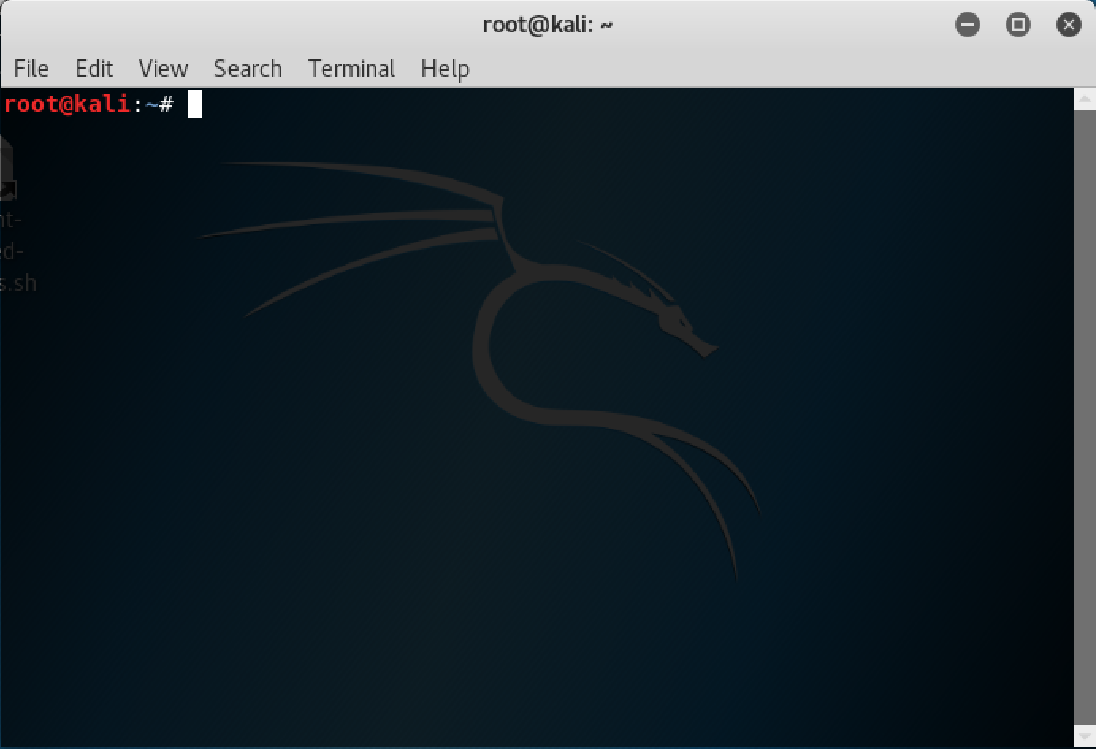

Slide 52
Proxy Rules
Modification of packet communication rules.
▼
▼
▼
Rule
Protocol
Port
▼
Chain
xxx.xxx.xxx.xx:xxxx
129.126.132.1
Command Line
Input
▼
Forward
Block Communication | Source: 129.126.132.1| Protocol: All| Port: 2500
Output
▼
Add
OK
Delete

